Slide 1
Interrupts and Low Power Features
Notes:
Hello and welcome.
In this video, we will look at interrupts and low power features.

Slide 2
Module Syllabus
Interrupts
What are interrupts?
Why use interrupts?
Exception handler
Entering an exception handler
Exiting an exception handler
Timing analysis
Program design with interrupts
Sharing data safely between ISRS and other threads
Notes:
We will provide a general introduction of interrupts and their handlers within the controller and the Arm architecture.
We will also go through exceptions, microcontroller interrupts, timing analysis, program design with interrupts, and sharing data safely between interrupt service routines (ISRs) and other threads.

Slide 3
Interrupts, Exceptions, and ISR
Types of interrupts:
Hardware interrupts
Asynchronous: not related to what code the processor is currently executing
Examples: interrupt is asserted, character is received on serial port, or ADC converter finishes conversion
Exceptions, faults, software interrupts
Synchronous: are the result of specific instructions executing although external write faults are asynchronous
Examples: undefined instructions, overflow occurs for a given instruction
We can enable and disable (mask) most interrupts as needed (maskable), others are non-maskable
Interrupt service routine (ISR)
ISR, subroutine that handles the interrupt, which processor is forced to execute
After ISR completes, MCU goes back to previously executing code
Notes:
There are different types of interrupts: asynchronous interrupts and synchronous interrupts.
Regular interrupts are based on asynchronous external events; for example, they are created by ADC conversions, or data received at serial ports. Asynchronous interrupts are generated by other hardware devices.
Synchronous interrupts are produced by the processor while executing instructions. Software interrupts or exceptions usually occur synchronously, which means they are the result of undesirable behavior of executed instructions. Because they happen while instructions are executed at the same time as the code, they are called “synchronous”.
An exception is 'synchronous' if it can be linked causally to the specific instruction which caused it.
Most interrupts can be masked; that is, they can be disabled. The term “masked” comes from the bit mask, which is defined to filter unneeded or unwanted interrupts. But not all interrupts are maskable; for example, the watchdog interrupt is not maskable. In this case, they are called non-maskable interrupts (NMIs).
The code that is being forced to be executed by an interrupt is called interrupt service routine (ISR).

Slide 4
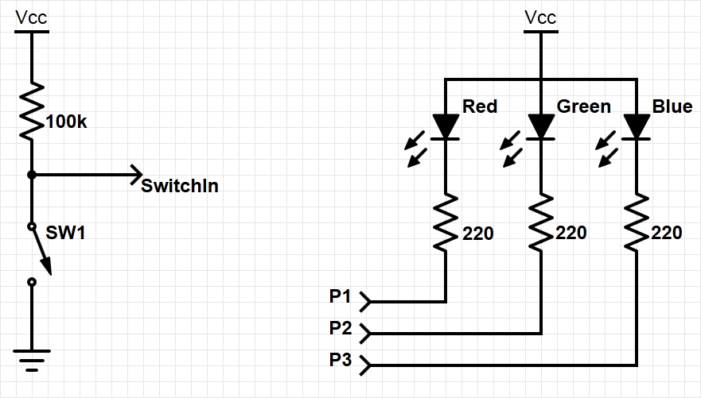
Example System with Interrupt
Goal: to change the color of the RGB LED when the switch is pressed
Need to add an external switch
(resistor is internal – a pull-up resistor)
Notes:
Let’s consider the following example:
Using a switch, we want to change the color of an RGB LED when it is pressed. To do this, we apply an external switch to a GPIO pin on the controller. In order to prevent the GPIO pin from being “open”, we will use a pull-up resistor as shown in the slide.
In the following slides, you will see how to implement interrupts by using this example system.

Slide 5
How Can We Detect When a Switch Is Pressed?
One option is polling i.e. using software to check it regularly. However, polling is:
Slow – user needs to check to see if switch is pressed
Wasteful of CPU time – the faster the response needed, the more often user needs to check
Not scalable – it’s difficult to build a multi-activity system that can respond quickly. The system’s response time depends on all other processing it has to do.
A better option is an interrupt i.e. using special hardware in the MCU to detect and run ISR in response. An interrupt is:
Fast – it’s a hardware mechanism
Efficient – the code runs only when necessary
Scalable:
ISR response time doesn’t depend on most other processing
Code modules can be developed independently
Notes:
There are two ways to detect when a switch is pressed or not: the polling method and the use of interrupts.
Polling is the method in which the microcontroller is continuously checking the status of a flag. It is slow, inefficient, and poorly scalable. The more GPIO or other events have to be polled, the more time is needed. So there is a natural limit to the number of supervised GPIOs possible at a given processor speed.
However, an interrupt-based routine only runs the code when it is called/initiated by the interrupt service routine. This routine directly executes addressed code, sometimes without any CPU interaction. Therefore, it is fully scalable, because it is independent from the number of monitored events, so the supervision doesn’t consume CPU time.

Slide 6
Interrupt or Exception Processing Sequence
Main code is running.
When the interrupt trigger occurs:
The processor does some hard-wired processing
The processor executes the ISR, including return-from-interrupt instruction at the end
Then the processor resumes running main code
Hardwired CPU response activities
Interrupt routine
Main code
Time
Notes:
The term “interrupt” is self-explanatory: many interrupts can occur same time and hence interrupts also have a priority defined, it interrupts (nearly) everything in order to execute its own code. While each interrupt’s configuration determines what is actually interrupted, if the interrupt is active, then the regular program code will be stopped.
After stopping the main code, some hardwired routines such as saving registers are performed before the interrupt routine is started.
All steps will be reversed after the interrupt routine is finished and the regular program execution continues.

Slide 7
Interrupts
Hardware-triggered asynchronous software routine
Triggered by hardware signal from peripheral or external device
Asynchronous – can happen anywhere in the program (unless interrupt is disabled)
Software routine – interrupt service routine runs in response to interrupt
Fundamental mechanism of microcontrollers
Provides efficient event-based processing rather than polling
Provides quick response to events regardless of program state, complexity, location
Allows many multithreaded embedded systems to be responsive without an operating system (specifically task scheduler)
Notes:
Interrupts are classified as asynchronous, in the way that it is non-predictable, event-driven, and needing a dedicated trigger.
Therefore, asynchronous controller internal events need to be generated, and these are normally hardware-based pre-processed. In the next step, linked by an internal jump to a dedicated memory area, this code may directly be executed within any significant involvement of the CPU.
This is fundamental for microcontroller programming because it allows for minimalism, special task design, and power and run-time sensitivity. So the controller must be prevented from carrying out unnecessary tasks by operating in a passive mode as long as possible, mostly responding to events and triggers only. Based on this principle, multithreading can be emulated by hardware interrupts without the need for an operating system: The basic operation runs in a main task. Whenever something important happens, this task can be interrupted for a prioritized one. If there is repettitive work, this can be run as a main task (or the core can sleep).

Slide 8
Example Program Requirements and Design
MAIN
RGB LED
SW
ISR
Count
(does initialization, then updates LED based on count)
Global variable
ISR
MAIN
When switch SW is pressed, ISR will increment count variable
Main code will light LEDs according to count value in binary sequence (Blue: 4, Green: 2, Red: 1)
Main code will toggle its debug line each time it executes
ISR will raise its debug line (and lower main’s debug line) whenever it is executing
Notes:
Going back to our example, the program can be divided into three segments: the main code, the ISR, and a global variable.
As shown in the slide, the main code does the initialization, lights the RGB LED according to the global variable value, and toggles the debug line for every loop iteration.
The ISR is triggered only when the switch is pressed. The ISR will increment the global variable value. The ISR also sets the debug line whenever it is executing.

Slide 9
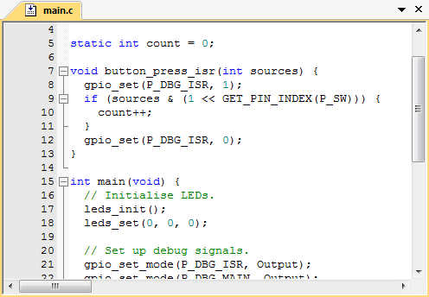
Example Exception Handler
Now we will examine the processor’s response to exception in detail:
Notes:
In this slide, the exception handling is shown in the source code. An exception is any condition that needs to halt normal execution of the instructions, such as core resets, failures, or interrupts.
The yellow part of the source code indicates the definition and initialization line of the counter. The functional code of incrementing the counter is located in the ISR (red): It is activated by an interrupt on the pin to which the switch is connected. Here, a counter is incremented, controlling the RGB LED.
In the main routine (green), only the initialization and the connection of the ports to the ISR are made.

Slide 10
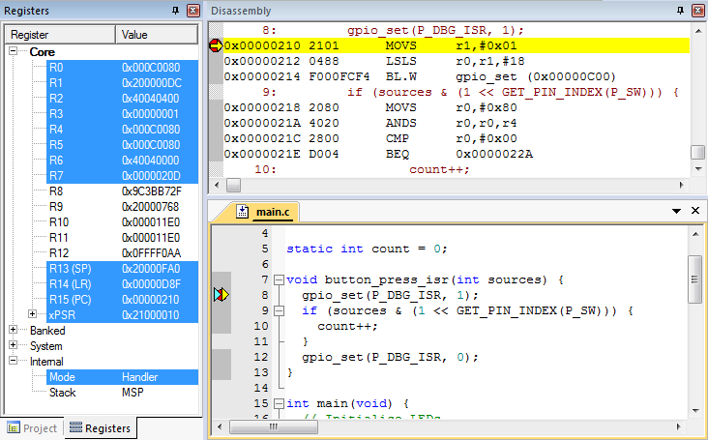
Use Debugger for Detailed Processor View
Can see registers, stack, source code, disassembly (object code)
Note: compiler may generate code for function entry
Place breakpoint on the handler function declaration line in source code, not at the first line of code
Notes:
We can use the debugger to observe the exception handling steps in detail. It is an advantage to follow the next steps within an extended IDE, with assembly and a register section, so that every step of the exception handling can be observed inside the register. To see all the steps, you must set a break point in the first line of the exception handler (here: line 8).

Slide 11
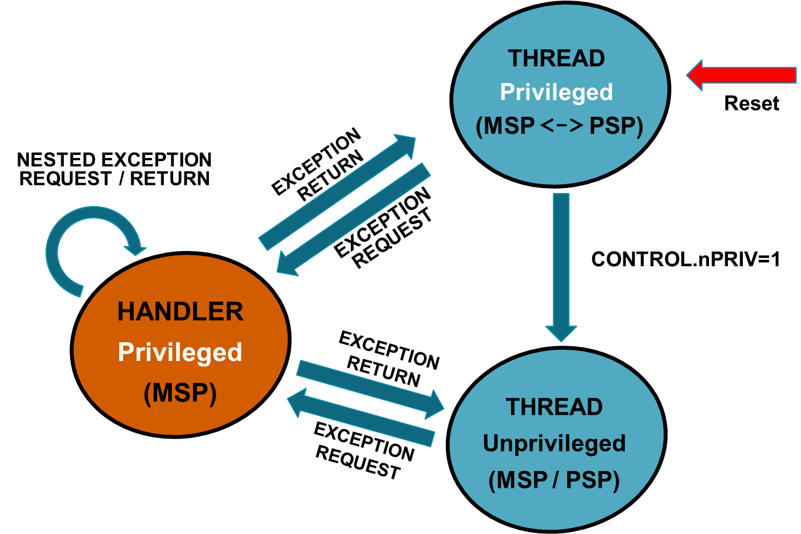
Recap on Thread and Handler modes
Cortex-M7 is an implementation of Armv7-M processor.
Two operating modes in Armv7-M:
Thread mode
Handler mode
Notes:
The Cortex-M7 has two operating modes, which are thread mode and handler mode.
The thread mode is used for application execution and can either use the
Main stack pointer (MSP)
Process stack pointer (PSP)
The thread mode can be either
Privileged mode
Unprivileged mode
Note that at reset, the processor is in privileged mode and uses the MSP.
The handler mode is used for exception handling. It is entered on an exception and is always in privileged mode. It only uses the MSP.

Slide 12
Entering Exception Handler: CPU Hardwired Exception Processing
Finish current instruction
Except for lengthy instructions
Push context (registers) onto current stack (MSP or PSP)
xPSR, Return Address, LR(R14), R12, R3, R2, R1, R0
Switch to handler/privileged mode, use MSP
Load PC with address of interrupt handler
Load LR with EXC_RETURN code
Load IPSR with exception number
Start executing code of interrupt handler
There are usually 16 cycles from exception request to execution of first instruction in handler
Notes:
This slide summarizes the steps when entering an exception handler.
After the exception is triggered, the current instruction (unless it is a lengthy instruction) of the operating code finishes before the interrupt execution process starts. The current architectural state is then saved onto the stack and then the interrupt routine is prepared (load PC instruction). Afterward, the EXC_RETURN values are loaded in the link register (LR). The Interrupt Program Status Register (IPSR) is also loaded with the correct exception number that is to be executed. The interrupt handler code is then executed.
There are usually sixteen cycles from exception request to execution of first instruction in the handler. This duration is also known as the interrupt latency.
The steps are explained in more detail in the following slides.

Slide 13
1. Finish Current Instruction
Most instructions are short and finish quickly
Some instructions may take many cycles to execute
Load Multiple (LDM), Store Multiple (STM), Push, Pop, MULS (32 cycles for some CPU core implementations)
This will delay interrupt response significantly
If one of these is executing when the interrupt is requested, the processor:
abandons the instruction
responds to the interrupt
executes the ISR
returns from interrupt
restarts or resumes the abandoned instruction as appropriate
Notes:
Exception entry occurs when there is a pending exception with sufficient priority, and either the processor is in thread mode or the new exception is of higher priority than the exception being handled, in which case, the new exception pre-empts the original exception.
Some instructions can take several cycles to complete, and this would delay the interrupt. If the current executing instruction takes many cycles to execute, then the instruction is abandoned and is restarted after the ISR execution.
Load multiple instructions can be interrupted and resumed between individual transfers.

Slide 14
2. Push Context onto Current Stack
 |  | <previous> | SP points here before interrupt
 | SP + 0x1C | xPSR
 | SP + 0x18 | PC
Decreasing | SP + 0x14 | LR
memory | SP + 0x10 | R12
address | SP + 0x0C | R3
 | SP + 0x08 | R2
 | SP + 0x04 | R1
 | SP + 0x00 | R0 | SP points here upon entering ISR
Two SPs: Main (MSP), process (PSP)
Which is active depends on operating mode, CONTROL register bit 1
Stack grows toward smaller addresses
Notes:
Similar to calling a subroutine, the processor pushes information onto the current stack (PC, xPSR, LR, and registers) before beginning to execute the exception code. The operation of pushing content to the stack is called stacking. A stack frame is a frame of data that gets pushed onto the stack (i.e., 8 words in this case). Note that a word is defined as 32 bits (4 bytes) in Arm architecture.
There are two stack pointers (SPs): MSP and PSP. The processor uses the MSP or the PSP depending on the operating mode, which is either thread mode or handler mode.
In thread mode, the CONTROL register bit [1] controls whether the processor uses the MSP or PSP.
In handler mode, the processor always uses MSP.
After the routine has terminated, it will be restored and will continue from this point.

Slide 15
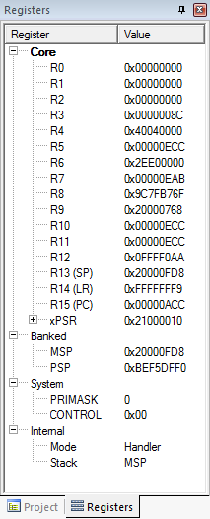
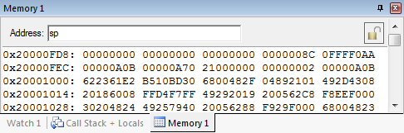
Context Saved on Stack
SP value is reduced since registers have been pushed onto stack
Saved R0
Saved R1
Saved R2
Saved R3
Saved R12
Saved LR
Saved PC
Saved xPSR
Notes:
This memory snapshot shows the saved registers on the stack. Each word in the stack now holds the value of each one of the registers that are pushed in the stack (stack frame).

Slide 16
3. Switch to Handler/Privileged Mode
Handler mode always uses main SP
Reset
Thread
Mode. MSP or PSP
Exception Processing
Completed
Starting Exception Processing
Handler Mode
MSP
Notes:
After saving the registers and before executing the ISR-code, the execution of the exception needs to be prepared. To do this, the code execution must be switched into privileged mode, so the processor has more access to the core functions, such as full access to the MSR, the MRS instructions, the CPS instructions, and access to the system timer, NVIC, or system control block.
Note that the handler mode always uses the MSP, and it is always privileged.
This needs to be reversed again after finishing the exception code and returning to normal operation.

Slide 17
Handler and Privileged Mode
Mode changed to Handler.
Was already using MSP
Notes:
In this slide, you can see that the exception handler is triggered and the execution mode is changed from thread to handler mode. Code in handler mode is always executed as privileged, and therefore the core will automatically switch to privileged mode when exceptions occur.

Slide 18
Update IPSR with Exception Number
Exception number 0x10 (interrupt number + 0x10)
Notes:
Another change that takes place after the exception handler has been triggered is the value of the IPSR, which is bit position [8:0] in the xPSR register. According to IPSR bit assignments, 0x10 stands for the interrupt exception handler type.

Slide 19
4. Load PC with Address of Exception Handler
Memory address | Value
0x0000_0000 | Initial Stack Pointer
0x0000_0004 | Reset
0x0000_0008 | NMI_IRQHandler
…
 | IRQ0_Handler
 | IRQ1_Handler
…
Reset:
…
NMI_IRQHandler:
…
IRQ0_Handler:
…
IRQ1_Handler:
Which program counter is selected from the vector table depends on which exception is used
Notes:
When an exception is triggered, the program counter is loaded with the corresponding exception handler code according to the exception handler type (shown in this diagram), which is based on the vector table.

Slide 20
Examine Vector Table with Debugger
Exception number | IRQ number | Vector | Offset
 |  | Initial SP | 0x00
1 |  | Reset | 0x04
2 | -14 | NMI | 0x08
3 | -13 | HardFault | 0x0C
4 |  | Reserved | 0x10
5
6
7
8
9
10
11 | -5 | SVCall | 0x2C
12 |  | Reserved
13
14 | -2 | PendSV | 0x38
15 | -1 | SysTick | 0x3C
16 | 0 | IRQ0 | 0x40
17 | 1 | IRQ1 | 0x44
18 | 2 | IRQ2 | 0x48
. |  | .
16+n | n | IRQn | 0x40+4n
Why is the vector odd?
LSB of address indicates that handler uses Thumb code
Notes:
The vector table contains the reset value of the SP, and the start addresses, also called exception vectors, for all exception handlers. The least significant bit of each vector must be 1, indicating that the exception handler is Thumb code. The Cortex-M7 processor supports execution of instructions in Thumb state.

Slide 21
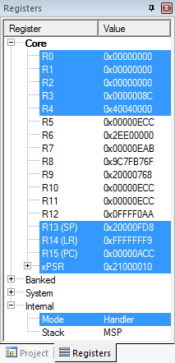

Upon Entry to Handler
PC has been loaded with start address of handler
Notes:
Here, the program counter is loaded with the address of the first instruction of the exception handler code.

Slide 22
5. Load LR with EXC_RETURN Code
EXC_RETURN value generated by CPU to provide information on how to return
Which SP to restore registers from? MSP (0) or PSP (1)?
Previous value of SPSEL
Which mode to return to? Handler (0) or Thread (1)?
Another exception handler may have been running when this exception was requested
Notes:
When stacking is complete, the processor starts executing the exception handler. At the same time, the processor writes an EXC_RETURN value to the link register (LR). This indicates which SP corresponds to the stack frame and what operation mode the processor was in before the entry occurred.

Slide 23
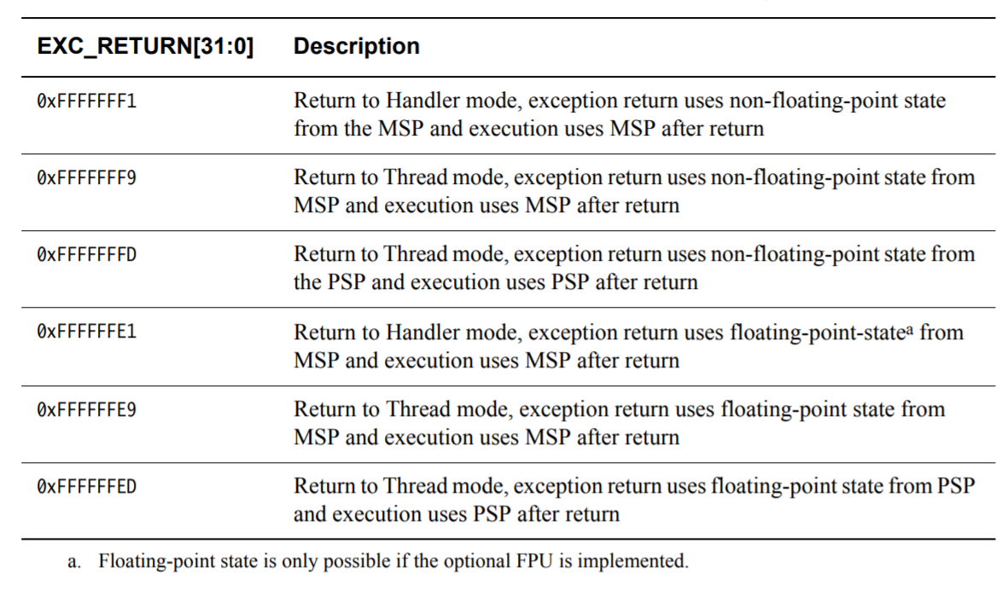
5. Load LR with EXC_RETURN Code
Notes:
The table shows the Cortex-M7 EXC_RETURN values and what they correspond to.
For more information, see the Cortex-M7 Device Generic User Guide.

Slide 24
Updated LR with EXC_RETURN Code
Notes:
In this example, the LR has been loaded with 0xFFFF_FFF9 EXC_RETURN code. This code reveals that it will return to normal thread mode and uses MSP after ISR execution.

Slide 25
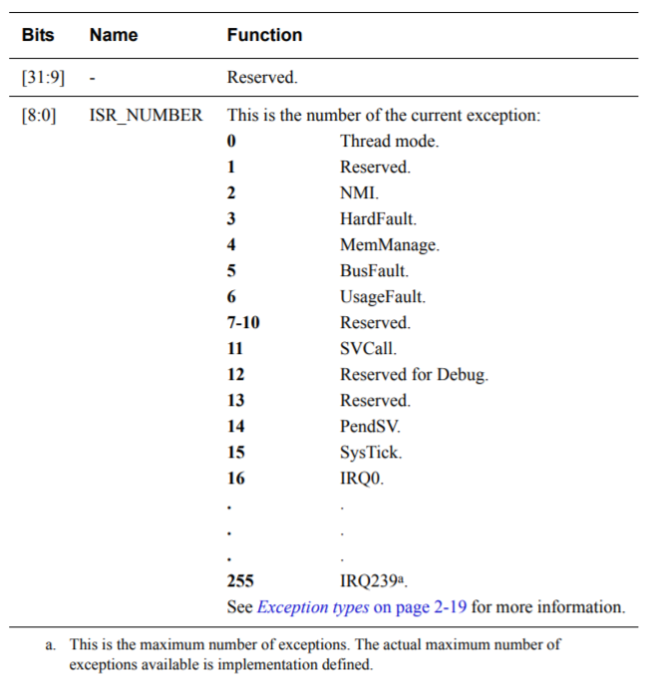
6. Load IPSR with exception number
Interrupt Program Status Register (IPSR)
Exception type number
Notes:
In addition, the processor also performs operations such as updating the IPSR with the exception number that it is accepting.
This table shows the corresponding exception types based on numbers 1 to 255 in the IPSR.

Slide 26
7. Start Executing Exception Handler
Exception handler starts running, unless preempted by a higher-priority exception
Exception handler may save additional registers on stack
e.g. if handler may call a subroutine, LR and R4 must be saved
Notes:
After steps 1 to 6, the exception code now starts execution. If nested interrupts are allowed, this can be stopped by another higher priority interrupt. Otherwise, nested interrupts may also be prohibited. In that case, only high-priority exceptions, such as a reset or watchdog event, may interrupt this code.

Slide 27
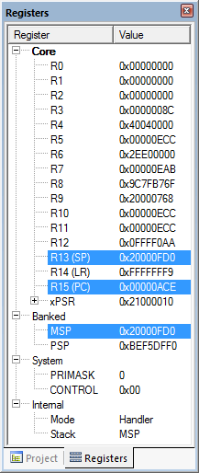
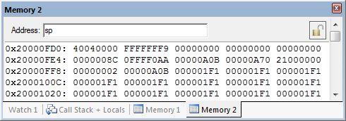
After Handler has Saved More Context
Saved R4
Saved LR
Saved R0
Saved R1
Saved R2
SP value reduced since registers have been pushed onto stack
Saved R3
Saved R12
Saved LR
Saved PC
Saved xPSR
Notes:
Now, in the handler, additional code has been executed, and register values have been pushed to the stack.
An exception handler may save additional registers on stack, for example, if the handler may call a subroutine, R4, and LR must be saved.

Slide 28
Exiting an Exception Handler
Execute instruction triggering exception return processing
Select return stack, restore context from that stack
Resume execution of code at restored address
Notes:
When exiting an exception handler, an instruction is first executed to trigger an exception return. The return stack is selected, and context is restored from that stack. The execution of code resumes at the restored address.
Exception return occurs when the processor is in handler mode and loads the EXC_RETURN value into the PC, in order to restore context and resume execution of the main code.
We shall look at the steps when exiting an exception handler in the following slides.

Slide 29

1. Execute Instruction for Exception Return
No “return from interrupt” instruction
Use regular instruction instead
BX LR - branch to address in LR by loading PC with LR contents
POP …, PC - Pop address from stack into PC
… with a special value EXC_RETURN loaded into the PC to trigger exception handling processing
BX LR used if EXC_RETURN is still in LR
If EXC_RETURN has been saved on stack, then use POP
Notes:
There is no special instruction for returning from an interrupt. The interrupt routine is terminated like a regular branch.
Depending on where the return address has been stored, either BX LR is used if the return address is still in LR or the return address has been stored on the stack and is recalled with POP.

Slide 30
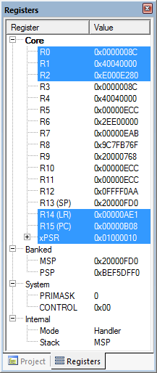
What will be Popped from Stack?
Instruction:
Register values:
R4: 0x4040_0000
PC: 0xFFFF_FFF9
Saved R4
Saved LR
Saved R0
Saved R1
Saved R2
Saved R3
Saved R12
Saved LR
Saved PC
Saved xPSR
Notes:
In the example shown in this slide, initially, R4 and PC will be popped from the stack. PC will then be loaded with the EXC_RETURN code.

Slide 31
2. Select Stack, Restore Context
Check EXC_RETURN (bit 2) to determine from which SP to pop the context
Pop the registers from that stack
EXC_RETURN | Return stack | Description
0xFFFF_FFF1 | 0 (MSP) | Return to exception handler with MSP
0xFFFF_FFF9 | 0 (MSP) | Return to thread with MSP
0xFFFF_FFFD | 1 (PSP) | Return to thread with PSP
 |  | <previous> | SP points here after handler
 | SP + 0x1C | xPSR
 | SP + 0x18 | PC
Decreasing | SP + 0x14 | LR
memory | SP + 0x10 | R12
address | SP + 0x0C | R3
 | SP + 0x08 | R2
 | SP + 0x04 | R1
 | SP + 0x00 | R0 | SP points here during handler
Notes:
After an instruction is executed for exception return, the return stack needs to be selected and the context needs to be restored.
If the return mode is set to “handler”, the controller may execute another interrupt; otherwise, it returns to the normal program execution.
Returning to the normal thread mode, the next step is to determine from which stack (MSP or PSP) the data should be restored. This decision is mainly made to prevent the main program from running out of stack space. Which stack to return to is defined by bit [2] of the EXC_RETURN: if it is 0, then the information is in the main stack; if 1, then it is in the process stack.

Slide 32
Example
PC=0xFFFF_FFF9, so return to thread mode with main stack pointer
Pop exception stack frame from stack back into registers
Saved R0
Saved R1
Saved R2
Saved R3
Saved R12
Saved LR
Saved PC
Saved xPSR
Notes:
In this example, according to the EXC_RETURN code, we are going to return to the thread mode with the MSP and pop the stack frame back to registers.

Slide 33
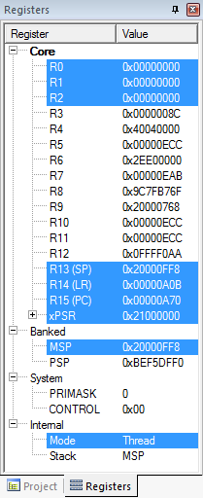
3. Resume Executing Previous Main Thread Code
Exception handling registers have been restored: R0, R1, R2, R3, R12, LR, PC, xPSR
SP is back to previous value
Back in thread mode
Next instruction to execute is at 0x0000_0A70
Notes:
Finally, all exception handling registers are restored (R0, R1, R2, R3, R12, LR, PC, xPSR), and the SP points to the value before the interrupt execution. The thread mode is active again, and the PC points to the next regular code instruction at 0x0000_0A70.
The system is in the same execution state as before the interrupt.

Slide 34
Nested Vectored Interrupt Controller (NVIC)
NVIC manages and prioritizes external interrupts
Interrupts are types of exceptions
Exceptions 16 through 16+N
Modes
Thread mode: entered on reset
Handler mode: entered on executing an exception
Privilege level
Stack pointers
Main Stack Pointer (MSP)
Process Stack Pointer (PSP)
Exception states: Inactive, Pending, Active, A&P (Active & Pending)
Port module
Arm Cortex Core
Next module
NVIC
Another module
Notes:
The Nested Vectored Interrupt Controller (NVIC) provides configurable interrupt handling abilities to the processor. It facilitates low-latency exception and interrupt handling and controls power management.
The processor closely integrates the NVIC to deliver industry-leading interrupt performance. The NVIC includes a non-maskable interrupt (NMI) and supports up to 240 interrupts, each with up to 256 levels of priority.
The tight integration of the processor core and NVIC provides fast execution of ISRs, dramatically reducing the interrupt latency. This is achieved through the hardware stacking of registers and the ability to suspend load-multiple and store-multiple operations. Interrupt handlers do not require wrapping in assembler code, removing any code overhead from the ISRs. A tail-chain optimization also significantly reduces the overhead when switching from one ISR to another.
You can only fully access the NVIC in privileged mode, but you can cause interrupts to enter a pending state in user mode if you enable the Configuration and Control Register. Any other user mode access causes a bus fault.
Note that each exception can be either in the “inactive”, “pending”, “active”, or “active and pending” state.
Inactive: The exception is not active and not pending.
Pending: The exception is waiting to be serviced by the processor. An interrupt request from a peripheral or from software can change the state of the corresponding interrupt to pending.
Active: An exception that is being serviced by the processor but has not completed
Note: An exception handler can interrupt the execution of another exception handler. In this case, both exceptions are in the active state.
Active and pending: The exception is being serviced by the processor, and there is a pending exception from the same source.

Slide 35
NVIC Registers and State
Enable – allows interrupt to be recognized
Accessed through two registers (set bits for interrupts)
Set enable with NVIC_ISER, clear enable with NVIC_ICER
CMSIS Interface: NVIC_EnableIRQ(IRQnum), NVIC_DisableIRQ(IRQnum)
Pending – interrupt has been requested but is not yet serviced
CMSIS: NVIC_SetPendingIRQ(IRQnum), NVIC_ClearPendingIRQ(IRQnum)
Notes:
As mentioned before, the external interrupts are managed and prioritized by the NVIC.
A “nested interrupt” is an interrupt routine call within another active interrupt. This second interrupt is called “nested”.
There are two possible states: the “enable state”, which means that interrupts are recognized, and the “pending state”, which means that an interrupt has been requested and detected but is not serviced yet.
CMSIS is the Cortex Microcontroller Software Interface Standard, a vendor-independent interface for debugging that also provides commands for controlling the NVIC.

Slide 36
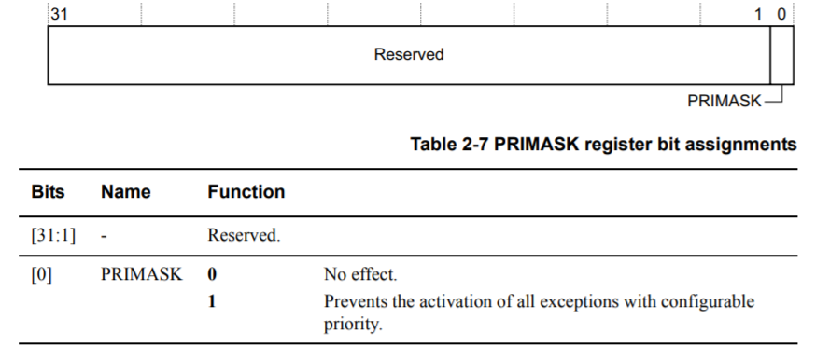
Core Exception Mask Register
PRIMASK – Exception mask register (CPU core)
Bit 0: PM Flag
Set to 1 to prevent activation of all exceptions with configurable priority
Clear to 0 to allow activation of all exception
Access using CPS, MSR and MRS instructions
Use to prevent data race conditions with code needing atomicity
Notes:
The exception mask registers disable the handling of exceptions by the processor. An example of the use of this register would be to disable exceptions when they might affect timing critical tasks. To access the exception mask registers, use the MSR and MRS instructions, or the CPS instruction to change the value of the priority mask (PRIMASK) register or FAULTMASK.
The PRIMASK register prevents activation of all exceptions with configurable priority. When the PRIMASK register bit is set, it prevents the activation of all exceptions with configurable priority.
This eliminates the problem of so-called data races. A data race occurs when two independent threats may access the same data. If one threat is manipulating data, another one also needs the, in this case unknown, order of operations. To prevent such a situation, the PM flag is set.
The CMSIS-Core API provides dedicated commands to manipulate the PRIMASK and the PM flag.

Slide 37
Core Exception Mask Register
CMSIS-CORE API
void __enable_irq() – clears PM flag
void __disable_irq() – sets PM flag
uint32_t __get_PRIMASK() – returns value of PRIMASK
void __set_PRIMASK(uint32_t x) – sets PRIMASK to x
Notes:
There are also CMSIS-Core APIs provided as dedicated commands to manipulate the PRIMASK and the PM flag.

Slide 38
Prioritization
Exceptions are prioritized to order the response simultaneous requests (smaller number = higher priority)
Priorities of some exceptions are fixed:
Reset: -3, highest priority
NMI: -2
Hard Fault: -1
Priorities of other (peripheral) exceptions are adjustable:
Value is stored in the interrupt priority register (IPR0-7)
0x00
0x40
0x80
0xC0
Notes:
The NVIC supports programmable priority levels of 0-255 for each interrupt. A higher level corresponds to a lower priority, so level 0 is the highest interrupt priority.
The reset has the highest priority (-3), and the external exceptions (interrupts) are adjustable to higher priorities. The values are stored in the Interrupt Priority Register.

Slide 39
Special Cases of Prioritization
Simultaneous exception requests?
Lowest exception type number is serviced first
New exception requested while a handler is executing?
New priority higher than current priority?
New exception handler preempts current exception handler
New priority lower than or equal to current priority?
New exception held in pending state
Current handler continues and completes execution
Previous priority level restored
New exception handled if priority level allows
Notes:
When multiple exceptions are valid at the same time (i.e., more than one exception occurs during execution of an instruction), they are handled by the core (after completing the execution of the current instruction), according to their priority.
So if there are simultaneous exceptions, the lowest exception type number is serviced first.
If there is a new exception when a handler is executing, the next step depends on the priority of the new exception.
If the new exception priority is higher, then the new exception handler preempts the current exception handler.
If the new exception priority is the same as or lower than the current one, then the new exception is held in a pending state. The current handler will continue and complete its execution. The previous priority level is restored, and the new exception is handled if the priority level allows for it.

Slide 40
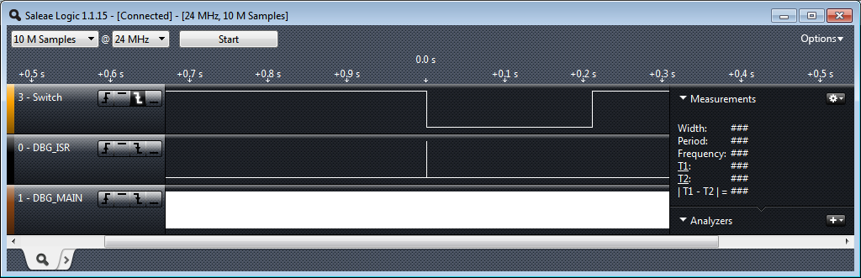
Timing Analysis: Big Picture Timing Behavior
Switch was pressed for about 0.21s
ISR runs in response to switch signal’s falling edge
Main seems to be running continuously (signal toggles between 1 and 0)
Does it really? You will investigate this in the lab exercise.
Notes:
In this and the next few slides, we are going to talk about the timing behavior and terminology of interrupts.
The example that we are using in this module is the switched LED.
The timing analysis shown here is made with the help of a logic analyzer. It is based on the switched LED example introduced in this lecture. We learned that the switch is pressed for 0.21 s, and the ISR is triggered in response to the falling edge of the signal switch. The DBG_MAIN signal is the debug signal that toggles on every loop iteration of our main code. Here, the interrupt seems not to be working because the DBG_MAIN signal is running continuously.

Slide 41
Interrupt Response Latency
Latency = time delay
Why do we care?
This is overhead, which wastes time and increases as the interrupt rate rises.
This delays our response to external events, which may or may not be acceptable for the application, such as sampling an analog waveform.
How long does it take?
Finish executing the current instruction or abandon it
Push various registers on to the stack, fetch vector
If we have external memory with wait states, this takes longer
Notes:
A very important aspect of interrupts is “latency”.
Latency is defined as the time delay between when the interrupts are triggered, and when the ISR begins to execute. In some applications, latency is critical; for example, when an analog waveform is sampled.
There are several side effects that can affect latency, which have to be taken into consideration. For example, latency is affected if the current executing instruction is finished or abandoned.

Slide 42
Maximum Interrupt Rate
We can only handle so many interrupts per second
FMax_Int: maximum interrupt frequency
FCPU: CPU clock frequency
CISR: Number of cycles ISR takes to execute
COverhead: Number of cycles of overhead for saving state, vectoring, restoring state, etc.
FMax_Int = FCPU/(CISR+ COverhead)
Note that model applies only when there is one interrupt in the system
When processor is responding to interrupts, it isn’t executing our other code
UInt: Utilization (fraction of processor time) consumed by interrupt processing
UInt = 100%*FInt* (CISR+COverhead)/ FCPU
CPU looks like it’s running the other code with CPU clock speed of (1-UInt)*FCPU
Notes:
The maximum interrupt frequency equals the CPU clock frequency, divided by the sum of the ISRs, plus the interrupt overhead cycles.
Note that the higher the interrupt frequency, the less time there is for the CPU to execute the other code.

Slide 43
Program Design with Interrupts
How much work to do in ISR?
Trade-off: faster response for ISR code will delay completion of other code
In system with multiple ISRs with short deadlines, perform critical work in ISR and buffer partial results for later processing
Should ISRs re-enable interrupts?
How to communicate between ISR and other threads?
Data buffering
Data integrity and race conditions
Volatile data – can be updated outside of the program’s immediate control
Non-atomic shared data – can be interrupted partway through read or write, is vulnerable to race conditions
Notes:
We have to take several design-time decisions, related to the interrupt implementation, when we are designing a program with interrupts.
First, we must consider the amount of work that will be assigned to an interrupt. We have to deal with the time that is going to be spent in between ISRs and other code. If we have multiple ISRs, it is better to assign them to perform only critical work and to buffer the rest for later processing.
Another important question is whether ISRs should be in charge of re-enabling interrupts. This is because we do not want to have an ISR running for long with all interrupts disabled, and it might be preferable for a long-running ISR to re-enable interrupts. On the other hand, if an ISR is fast and efficient, then there is no need for such an action.
One way to communicate between ISRs and other code is software data buffering, which is generally used as a communication interface. We must always keep data integrity and race conditions in mind.

Slide 44
Volatile Data
Compilers assume that variables in memory don’t change spontaneously,
Compilers optimize based on that belief
Don’t reload a variable from memory if current function hasn’t changed it
Read variable from memory into register (faster access)
Write back to memory at the end of the procedure, or before a procedure call, or when compiler runs out of free registers
Notes:
Volatile data is data that may be changed in other parts of the software.
To optimize code generation and improve run-time, the compiler makes some assumptions about code behavior. One key assumption is that all data behave in an atomic manner, whether it does or does not. Because changes from outside are not expected, some variables may be loaded into registers (performance improvements), and write the register values back to memory at the end of the procedure, or when there is a need.
This optimization can fail, however, and we will talk about this in the next slide.

Slide 45
Volatile Data
This optimization can fail
Example: reading from input port, polling for key press
While (SW_0) ; will read from SW_0 once and reuse that value
Will generate an infinite loop triggered by SW_0 being true
Variables for which it fails
Memory-mapped peripheral register – register changes on its own
Global variables modified by an ISR – ISR changes the variable
Global variables in a multithreaded application – another thread or ISR changes the variable
Notes:
One example where the compiler optimization may fail is as follows. Consider an application that is reading from an input port, polling for key press, and the switch state is represented by the variable SW_0.
If SW_0 is changed by an interrupt routine, this change will not be recognized, as this variable will not update within the while loop. For example, the memory-mapped peripheral register changes on its own.
Other situations that might prompt failure are also indicated in this slide.

Slide 46
The Volatile Directive
We need to tell compiler which variables may change outside of its control
Use volatile keyword to force compiler to reload these vars from memory for each use volatile unsigned int num_ints;
Pointer to a volatile int volatile int * var; // or int volatile * var;
Now each C source read of a variable (e.g. status register) will result in an assembly language LDR instruction
See explanation in Nigel Jones’ “Volatile,” Embedded Systems Programming July 2001
Notes:
The indicator for potential external changes is the compiler keyword “volatile”.
Volatile data is data that may be changed in other parts of the software.
If a variable is declared using the keyword volatile (e.g., volatile int a), then a compiler will reload the variable before every use. However, be careful with the use of this declaration because doing this may slow down your code (especially very efficient, atomic code) significantly.

Slide 47
Non-atomic Shared Data
void GetDateTime(DateTimeType * DT){
DT->day = current_time.day;
DT->hour = current_time.hour;
DT->minute = current_time.minute;
DT->second = current_time.second;
}
We want to keep track of current time and date
Use 1 Hz interrupt from timer
System:
current_time structure tracks time and days since some reference event
current_time’s fields are updated by periodic 1 Hz timer ISR
void DateTimeISR(void){
current_time.second++;
if (current_time.second > 59){
current_time.second = 0;
current_time.minute++;
if (current_time.minute > 59) {
current_time.minute = 0;
current_time.hour++;
if (current_time.hour > 23) {
current_time.hour = 0;
current_time.day++;
… etc.
}
Notes:
A good example is a clock application shown here.
It is called at 1 Hz by an interrupt, increasing the seconds-counter by 1. The timer interrupt not only performs the atomic operation of increasing the counter, but also checks the correct assignment to minutes, hours, and days. Additionally, a routine defines GetDateTime, copying the data to a DateTimeType pointer.
Now, if there is poor timing between interrupt and function call, an inconsistent situation may occur, as indicated in the next slide. This situation is called “data race condition”.

Slide 48
Example: Checking the Time
Problem: An interrupt at the wrong time will lead to half-updated data in DT
Failure case
current_time is {10, 23, 59, 59} (10th day, 23:59:59)
Task code calls GetDateTime(), which copies the current_time fields to DT: day = 10, hour = 23
A timer interrupt occurs, which updates current_time to {11, 0, 0, 0}
GetDateTime() resumes executing, copying the remaining current_time fields to DT: minute = 0, second = 0
DT now has a time stamp of {10, 23, 0, 0}.
The system thinks time just jumped backwards one hour!
Fundamental problem: “race condition”
Preemption enables ISR to interrupt other code and possibly overwrite data
Must ensure atomic (indivisible) access to the object
Native atomic object size depends on processor’s instruction set and word size (32 bits for Arm)
Notes:
The problem arises when an interrupt is triggered during the execution of the GetDateTime function, while it is updating DT. The ISR changed the current time, which has as a result to update the rest of the DT members with the new values. Consequently, the DT beginning of data is older than the end, and therefore they are inconsistent. This faulty update of the DT variable is called “race condition”.
Race condition is an anomalous behavior due to unexpected critical dependence on the relative timing of events. The result of the example code depends on the relative timing of the read and write operations.
This problem is not simple to solve. Usually, it is a good idea to turn off the interrupts at the beginning of GetDateTime (), using the PRIMASK PM-flag, and turn it on again later. However, this may lead to missing an interrupt event and a 1-second-count, and the consequence is an incorrect time.

Slide 49
Examining the Problem More Closely
Protect any data object which both:
Requires multiple instructions to read or write (non-atomic access), and
Is potentially written by an ISR
How many tasks/ISRs can write to the data object?
If one, then we have one-way communication
Must ensure the data isn’t overwritten partway through being read
Writer and reader don’t interrupt each other
If more than one, we
Must ensure the data isn’t overwritten partway through being read
Writer and reader don’t interrupt each other
Must ensure the data isn’t overwritten partway through being written
Writers don’t interrupt each other
Notes:
The data that has to be protected is potentially changed by an ISR and requires multiple instructions to read or write (non-atomic access).
There are many boundary conditions to be met. For instance, if only one ISR or task writes to a data object, then we must ensure that data is not overwritten partway through being read. Consequently, writer and reader should not interrupt each other. Additionally, in the case of multiple ISRs that can write to data objects, we have to ensure that writers don’t interrupt each other as well.

Slide 50
Definitions
Race condition: Anomalous behavior due to unexpected critical dependence on the relative timing of events. Result of example code depends on the relative timing of the read and write operations.
Critical section: A section of code which creates a possible race condition. The code section can only be executed by one process at a time. Some synchronization mechanism is required at the entry and exit of the critical section to ensure exclusive use.
Notes:
So, to recap, a race condition is an anomalous behavior due to unexpected critical dependence on the relative timing of events. The result of the example code shown earlier depends on the relative timing of the read and write operations.
A critical section is a section of code that creates a possible race condition. The code section can only be executed by one process at a time. Some synchronization mechanism is required at the entry and exit of the critical section to ensure exclusive use.

Slide 51
Solution: Briefly Disable Preemption
Prevent preemption within critical section
If an ISR can write to the shared data object, need to disable interrupts
save current interrupt masking state in m
disable interrupts
Restore previous state afterwards (interrupts may have already been disabled for another reason)
Use CMSIS-Core to save, control and restore interrupt masking state
Avoid disabling interrupts. Disabling delays response to all other processing requests
Use as few instructions as possible, to make the time as short as possible
void GetDateTime(DateTimeType * DT){
uint32_t m;
m = __get_PRIMASK();
__disable_irq();
DT->day = current_time.day;
DT->hour = current_time.hour;
DT->minute = current_time.minute;
DT->second = current_time.second;
__set_PRIMASK(m);
}
Notes:
One solution for race condition is to briefly disable preemption, in order to prevent any interruption during critical section execution. If we know that an ISR (or more) can write to the shared data object, then we need to disable interrupts. This can be achieved with the help of CMSIS-Core, by saving the current PRIMASK state into a temporary variable, disabling interrupts, executing the critical code section, and, finally, restoring the PRIMASK register status.
CMSIS-Core (Cortex-M) implements the basic run-time system for a Cortex-M device and gives the user access to the processor core and the device peripherals.
In general, you should avoid disabling interrupts since it may affect other processing requests. If you need to disable interrupts, try to do so for as few instructions as possible, in order to make the time of the interrupt as short as possible.

